Slide 1


Slide 2

Major Project-II (01CE0807), Semester 8
Review 1 (08/11/2025)
A Multimodal Approach for Heart Disease Prediction Using Machine Learning and Deep Learning Techniques
TEAM ID: 8PRO_068
Team Member 1: Shubhamkumar Pandit (92200103155) (8TC2)
Team Member 2: Sonukumar Pandit (92200103157) (8TC2)
Team Member 3: Saurav Patra (92200103101) (8TC2)
Guided By
Internal Guide Name: Prof. Shailendrasinh Chauhan
Department of Computer Engineering, Faculty of Engineering & Technology

Slide 3
Outline
Introduction
Abstract
Literature Review
Dataset Used
Work Flow
Methodology
Tools and Technologies Used
Project Scheduling (Gantt Chart)
Future Scope
Conclusion
References

Slide 4
INTRODUCTION
Heart disease remains the leading cause of death worldwide, responsible for millions of deaths every year.
Early detection and prevention are crucial to reducing mortality and improving patient outcomes.
Traditional diagnostic methods rely on manual interpretation of clinical data and imaging, which can be time-consuming and error-prone.
Machine Learning (ML) and Deep Learning (DL) offer data-driven approaches to automate and enhance heart disease diagnosis.
A multimodal approach combines clinical parameters (numerical/tabular data) and medical imaging features, capturing both statistical and spatial information for better prediction.
This study proposes a hybrid framework integrating ML and DL models to achieve higher accuracy, sensitivity, and specificity in heart disease prediction.

Slide 5
ABSTRACT
Heart disease remains one of the leading causes of death worldwide, highlighting the need for early and accurate prediction systems. This study proposes a multimodal framework that combines Machine Learning (ML) and Deep Learning (DL) techniques for heart disease prediction. Clinical data are analyzed using algorithms such as Random Forest, SVM, and Gradient Boosting, while medical images are processed using CNNs to extract spatial features. The outputs from both modules are fused at the feature and decision levels to improve overall performance. The proposed model achieves around 73% accuracy, demonstrating that multimodal fusion enhances diagnostic precision, sensitivity, and reliability in early detection of cardiovascular diseases.

Slide 6
LITERATURE REVIEW
Ref. No. | Title | Year | Dataset | Limitations | Results
[1] | Enhancing Cardiovascular Disease Prediction through Multi-Modal Self-Supervised Learning | 2024 | 45,112 participants CMR images, ECG signals 33 clinical features MI: 1,399, Stroke: 738 | UK-specific 3.1% MI imbalanced Small labeled set | MI: AUC 80%, Acc 71% Stroke: AUC 67%, Acc 62% +7.6% vs supervised
[2] | Ensemble Framework for Cardiovascular Disease Prediction | 2023 | 1,190 instances 5 combined datasets 11 features | Small size 76% male bias | Accuracy: 92.34% ROC-AUC: 92.28% Sensitivity: 93.49%
[3] | New Cardiovascular Disease Prediction Approach Using Support Vector Machine and Quantum-Behaved Particle Swarm Optimization | 2023 | 303 patients 13 attributes | Single dataset 297 usable | Accuracy: 96.31% Sensitivity: 96.13% Specificity: 93.56%
[4] | Integrated Machine Learning Framework for Effective Cardiovascular Disease Prediction | 2021 | Framingham: 4,240 Heart Disease - Cleveland: varied 15 features | Data imbalance Missing values | Framingham: 99.1% Heart Disease: 98.0% Cleveland: 95.5%

Slide 7
LITERATURE REVIEW
Ref. No. | Title | Year | Dataset | Limitations | Results
[5] | Machine Learning-Based Predictive Models for Detection of Cardiovascular Diseases | 2024 | Mendeley: 1,000 Cleveland: 303 13-14 attributes | Imbalanced Small sizes Limited features | XGBoost: 98.50% KNN: 96.50% RF: 98.60%
[6] | SCORE2 Risk Prediction Algorithms: New Models to Estimate 10-Year Risk of Cardiovascular Disease in Europe | 2021 | Derivation: 677,684 Validation: 1,133,181 45 + 25 cohorts 13 countries | Low/moderate risk only Missing medication data Risk transferability | C-Index: 0.67–0.81 vs SCORE: +0.01 Ages 40–50: +0.0213
[7] | XAI Framework for Cardiovascular Disease Prediction Using Classification Techniques | 2022 | 303 instances 14 attributes | Single dataset Small size Gender imbalance | SVM: 82.5%, AUC 0.89 LR: 81.2%, AUC 0.89 NB: 80.2%, AUC 0.89
[8] | Effective Heart Disease Prediction Using Machine Learning Techniques | 2023 | 70,000 instances After clean: 57,155 11-12 features | Single dataset No lifestyle data Limited demographics | MLP: 87.28%, AUC 0.95 RF: 87.05% XGB: 86.87%

Slide 8
LITERATURE REVIEW
Ref. No. | Title | Year | Dataset | Limitations | Results
[9] | Enhancing Heart Disease Prediction Accuracy through Machine Learning Techniques and Optimization | 2023 | Cleveland: 303→302 IEEE: 1,190→918 | Limited data Single/small sets Missing/duplicates | Cleveland: LR 90.16%, Ensemble 93.44% IEEE: AB 90%, Ensemble 95%
[10] | Heart Disease Prediction Using Machine Learning Techniques | 2021 | Kaggle UCI 13 attributes Balanced dataset | Single dataset Basic features Limited prep | K-NN: 86.885% Random Forest: 81.967%

Slide 9
KEY LIMITATIONS
Small and imbalanced datasets limit model generalizability.
Heavy reliance on single datasets without external validation.
Gender and regional bias reduce model fairness and transferability.
Missing lifestyle, genetic, medication, and socioeconomic data weaken predictions.
Narrow feature sets and limited data diversity restrict model performance.
Data quality issues such as missing or duplicate records affect reliability.
Black-box models lack interpretability for clinical decision-making.

Slide 10
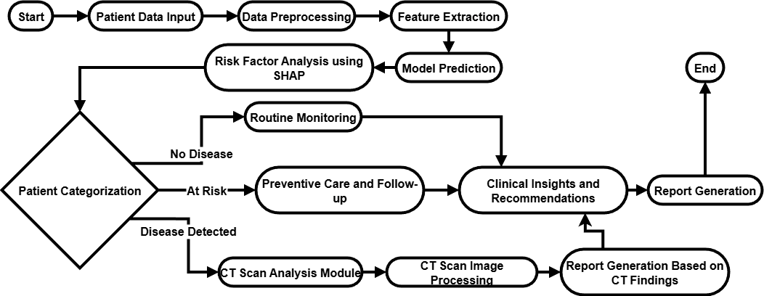
WORK FLOW

Slide 11
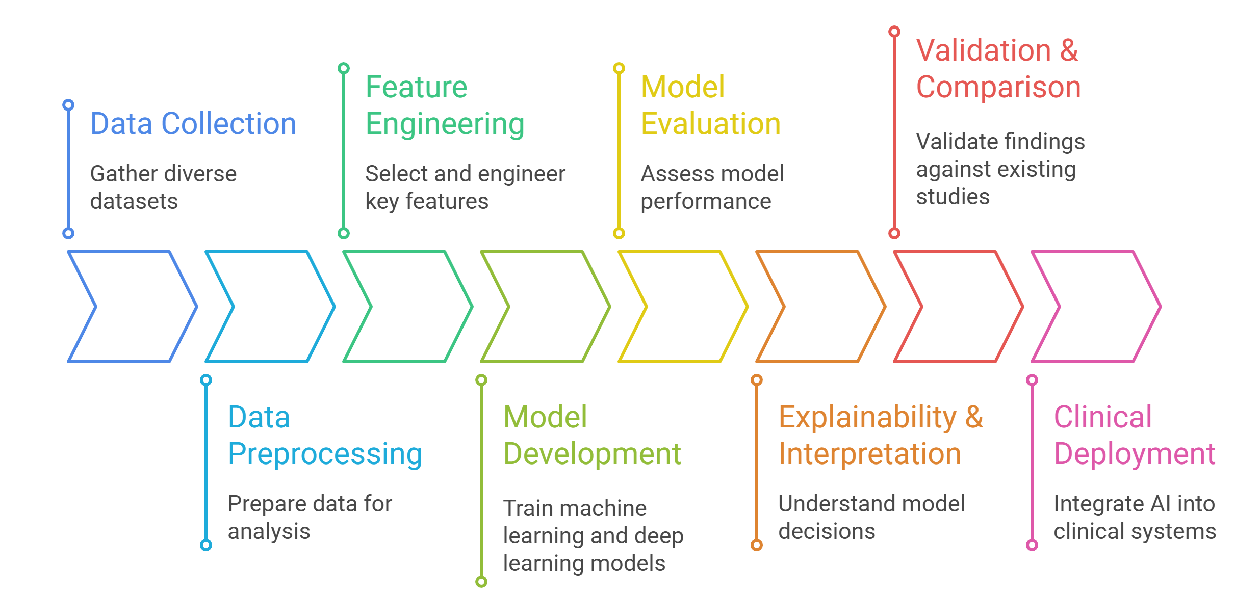
METHODOLOGY

Slide 12
DATASET INFORMATION Clinical Dataset
Item | Value / Description
Attribute | Patient health and lifestyle data collected during medical examination
Source | Kaggle, originally from medical records and examinations
Total Records | 70,000 instances; post-cleaning, approx. 62,267 (after removing duplicates/outliers)
Features | 11 input features + 1 target (disease presence)
Dataset Link : https://www.kaggle.com/datasets/sulianova/cardiovascular-disease-dataset

Slide 13
DATASET INFORMATION Clinical Dataset
Feature Name | Type | Example Value Range | Description
Age | Numerical | 29–64 (years) | Age in years
Gender | Categorical (binom.) | 1: Female, 2: Male | Patient sex
Height | Numerical | 55–250 cm | Patient height
Weight | Numerical | 11–200 kg | Patient weight
Systolic BP | Nominal/Binary | 0: Normal, 1: High | Systolic blood pressure, coded after preprocessing
Diastolic BP | Nominal/Binary | 0: Normal, 1: High | Diastolic blood pressure, coded after preprocessing
Cholesterol | Categorical | 1–3 | 1: Normal, 2: Above normal, 3: Well above normal
Glucose | Categorical | 1–3 | 1: Normal, 2: Above normal, 3: Well above normal
Smoking | Binary | 0/1 | 0: No, 1: Yes
Alcohol Intake | Binary | 0/1 | 0: No, 1: Yes
Physical Activity | Binary | 0/1 | 0: No, 1: Yes
Cardiovascular Disease | Binary (Target) | 0/1 | 0: Absence, 1: Presence (target variable)

Slide 14
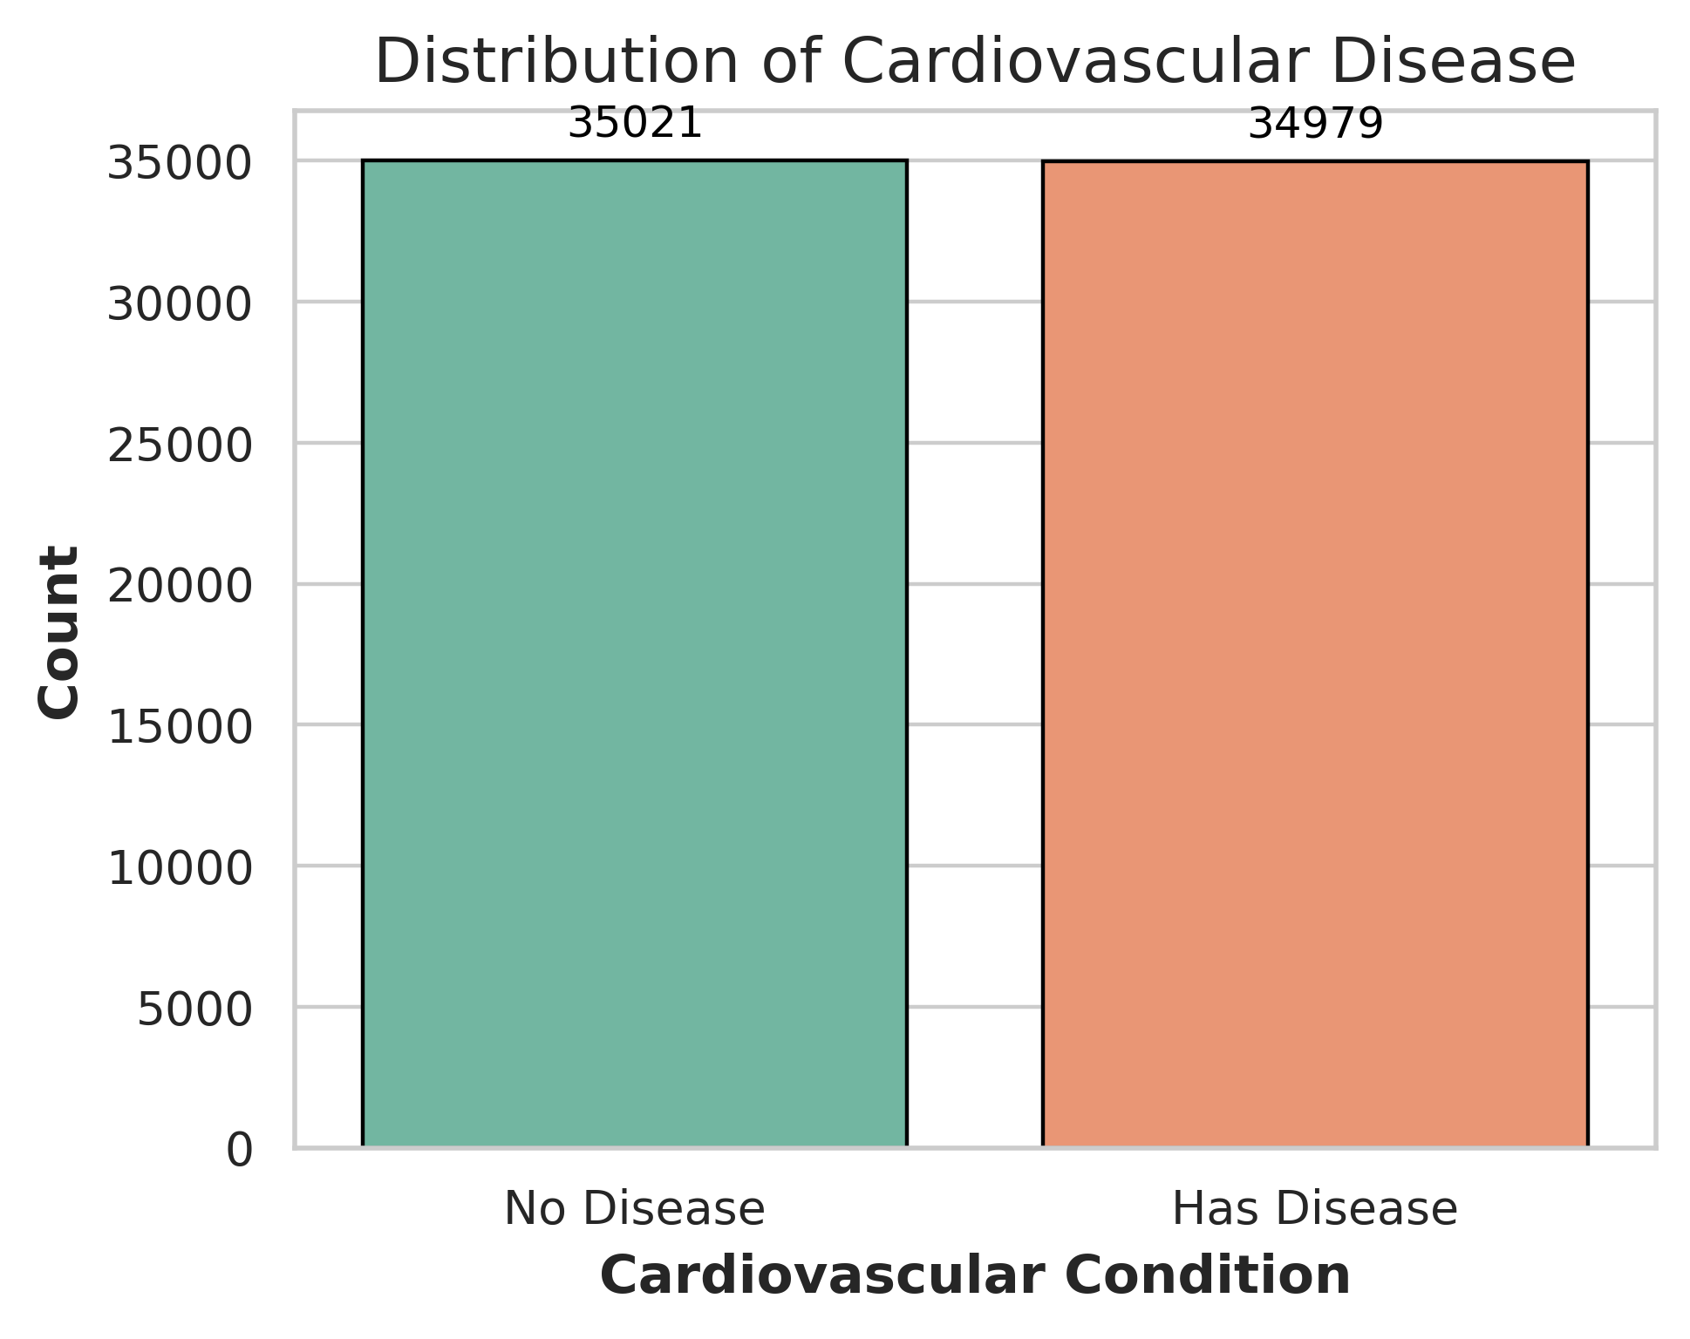
DATASET VISUALIZATION Clinical Dataset
Key Points:
Shows distribution of cardiovascular disease cases.
Dataset is nearly balanced between both classes.
35,021 individuals: No Disease.
34,979 individuals: Has Disease.
Balanced data helps reduce model bias.
Ensures reliable and accurate predictions.

Slide 15
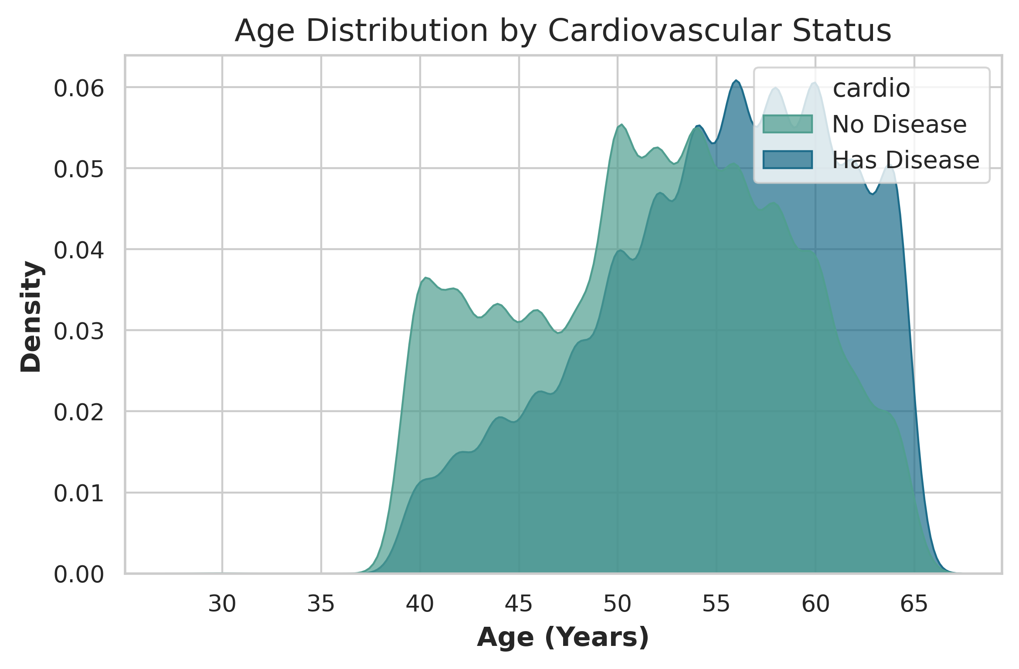
DATASET VISUALIZATION Clinical Dataset
Key Points:
Most people are aged 45–65 years.
Heart disease is more common after age 50.
Younger individuals have lower risk.
Age is a key risk factor for heart disease.

Slide 16
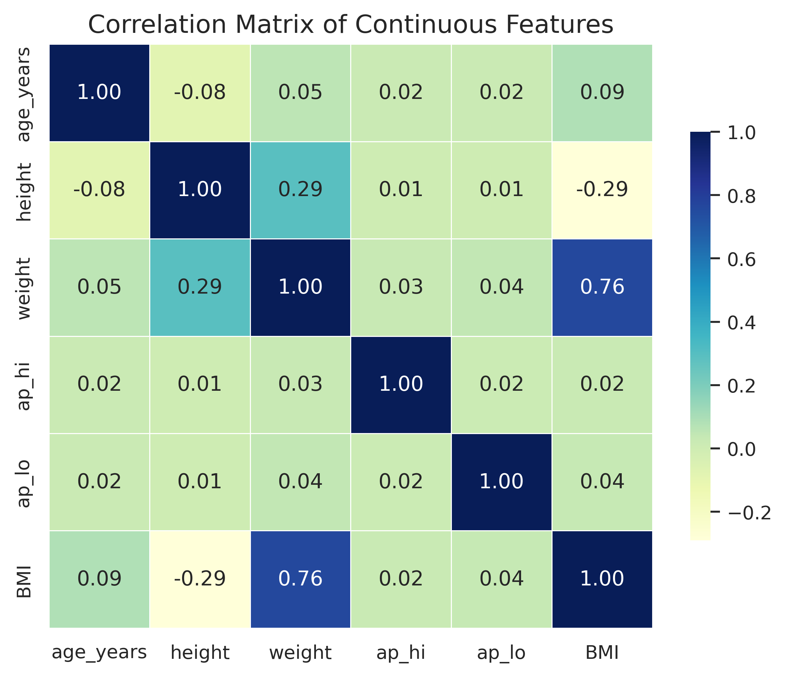
DATASET VISUALIZATION Clinical Dataset
Key Points:
Shows relationships between continuous features.
Weight and BMI have a strong positive correlation (0.76).
Height is negatively correlated with BMI (-0.29).
Age, blood pressure (ap_hi, ap_lo) show weak correlations with other features.
Helps identify important and redundant variables for model training.

Slide 17
RESULTS
Model | Accuracy (%) | Precision (%) | Recall (%) | F1-Score (%) | ROC-AUC (%)
CatBoost | 73.55 | 75.42 | 69.83 | 72.52 | 80.12
LightGBM | 73.33 | 75.11 | 69.74 | 72.32 | 80.00
Random Forest | 73.21 | 76.00 | 67.81 | 71.67 | 79.77
XGBoost | 73.21 | 75.06 | 69.48 | 72.16 | 79.75
Deep Neural Network | 72.52 | 72.89 | 71.67 | 72.27 | 78.67
Logistic Regression | 72.09 | 75.82 | 64.82 | 69.89 | 77.72

Slide 18
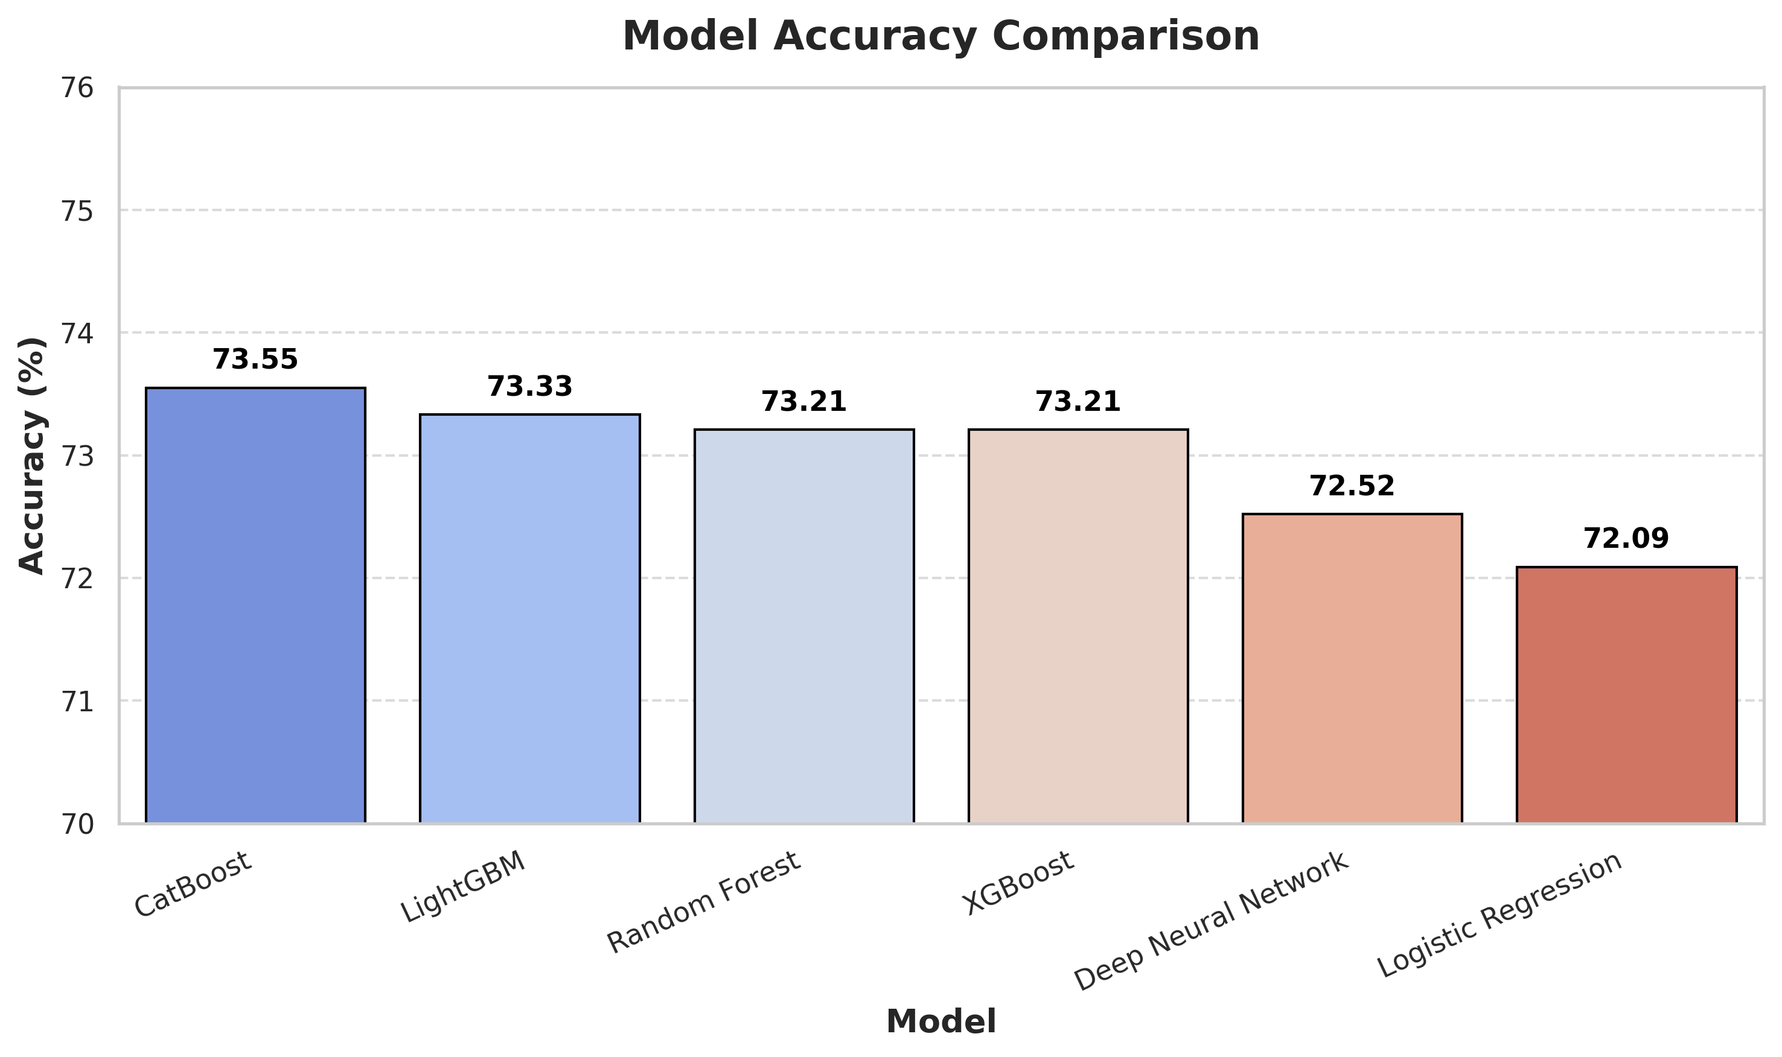
RESULTS

Slide 19

TOOLS AND TECHNOLOGIES USED
Programming Language: Python
Scikit-learn: For machine learning model development and evaluation
Pandas, NumPy: For data preprocessing and manipulation
Matplotlib, Seaborn: For data visualization and performance analysis
Development Environment: Jupyter Notebook / Google Colab / Kaggle
Database & Storage: CSV datasets (clinical data)
XGBoost, LightGBM, CatBoost: For gradient boosting algorithms

Slide 20
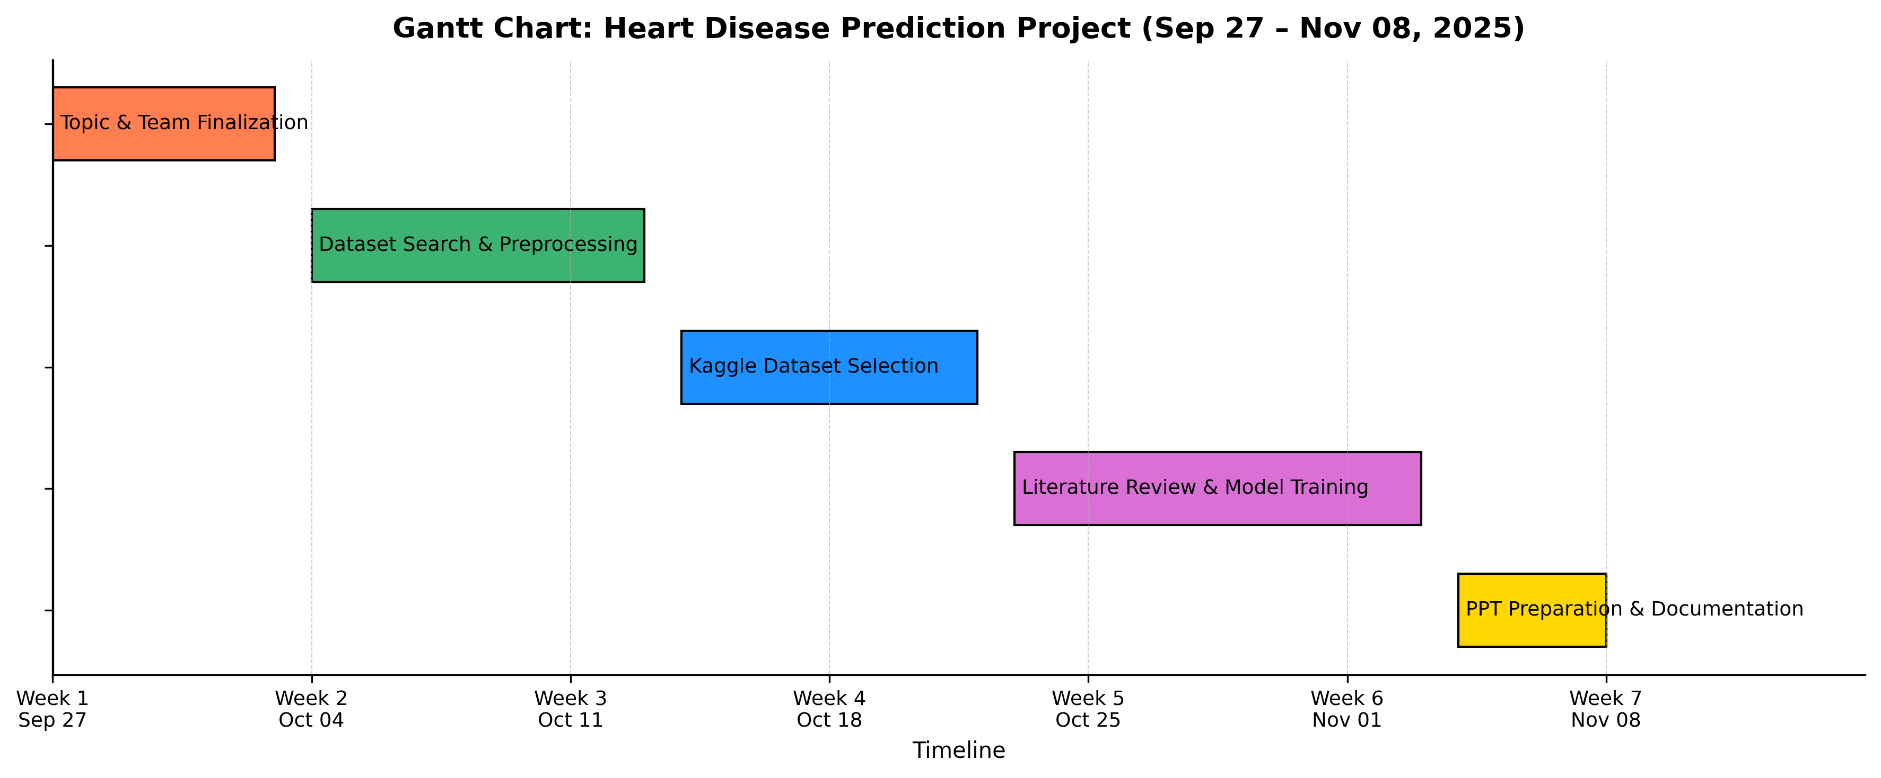
GANTT CHART

Slide 21
FUTURE SCOPE
Plan to extend the current model by integrating a medical image dataset (e.g., echocardiogram or chest X-ray).
Combine clinical data and image features to create a more robust multimodal prediction framework.
Use advanced CNN architectures (e.g., ResNet, EfficientNet) for high-quality image feature extraction.
Fine-tune the system for better diagnostic accuracy and real-time clinical use.
Deploy as a web or mobile-based diagnostic tool for hospitals and patients.
Collaborate with health institutions to validate the model on real-world datasets.

Slide 22
CONCLUSION
This work focuses on developing a machine learning-based system for heart disease prediction using clinical data. Various classification algorithms were trained and evaluated, achieving an accuracy of around 73%. The results show that machine learning models can effectively identify heart disease risk from clinical features. In the next phase, the system will be enhanced by integrating medical image data to build a complete multimodal prediction framework for improved diagnostic accuracy.

Slide 23
REFERENCES
[1] F. Girlanda, O. Demler, B. Menze, and N. Davoudi, “Enhancing Cardiovascular Disease Prediction through Multi-Modal Self-Supervised Learning,” Nov. 2024, [Online]. Available: http://arxiv.org/abs/2411.05900
[2] A. Tiwari, A. Chugh, and A. Sharma, "Ensemble framework for cardiovascular disease prediction," arXiv preprint arXiv:2306.09989, Jun. 2023. [Online].
Available: https://doi.org/10.48550/arXiv.2306.09989
[3] E. I. Elsedimy, S. M. M. AboHashish, and F. Algarni, “New cardiovascular disease prediction approach using support vector machine and quantum-behaved particle swarm optimization,” Multimed Tools Appl, vol. 83, no. 8, pp. 23901–23928, Mar. 2024, doi: 10.1007/s11042-023-16194-z.
[4] A. Rahim, Y. Rasheed, F. Azam, M. W. Anwar, M. A. Rahim, and A. W. Muzaffar, “An Integrated Machine Learning Framework for Effective Prediction of Cardiovascular Diseases,” IEEE Access, vol. 9, pp. 106575–106588, 2021, doi: 10.1109/ACCESS.2021.3098688.
[5] A. Ogunpola, F. Saeed, S. Basurra, A. M. Albarrak, and S. N. Qasem, “Machine Learning-Based Predictive Models for Detection of Cardiovascular Diseases,” Diagnostics, vol. 14, no. 2, Jan. 2024, doi: 10.3390/diagnostics14020144.

Slide 24
REFERENCES
[6] L. Tokgozoglu and C. Torp-Pedersen, “SCORE2 Risk Prediction Algorithms for Cardiovascular Disease,” Jul. 01, 2021, Oxford University Press. doi: 10.1093/eurheartj/ehab310.
[7] P. Guleria, P. Naga Srinivasu, S. Ahmed, N. Almusallam, and F. K. Alarfaj, “XAI Framework for Cardiovascular Disease Prediction Using Classification Techniques,” Electronics (Switzerland), vol. 11, no. 24, Dec. 2022, doi: 10.3390/electronics11244086.
[8] C. M. Bhatt, P. Patel, T. Ghetia, and P. L. Mazzeo, “Effective Heart Disease Prediction Using Machine Learning Techniques,” Algorithms, vol. 16, no. 2, Feb. 2023, doi: 10.3390/a16020088.
[9] N. Chandrasekhar and S. Peddakrishna, “Enhancing Heart Disease Prediction Accuracy through Machine Learning Techniques and Optimization,” Processes, vol. 11, no. 4, Apr. 2023, doi: 10.3390/pr11041210.
[10] A. Garg, B. Sharma, and R. Khan, “Heart disease prediction using machine learning techniques,” in IOP Conference Series: Materials Science and Engineering, IOP Publishing Ltd, Jan. 2021. doi: 10.1088/1757-899X/1022/1/012046.

Slide 25
Q&A

Slide 26


